Slide 1
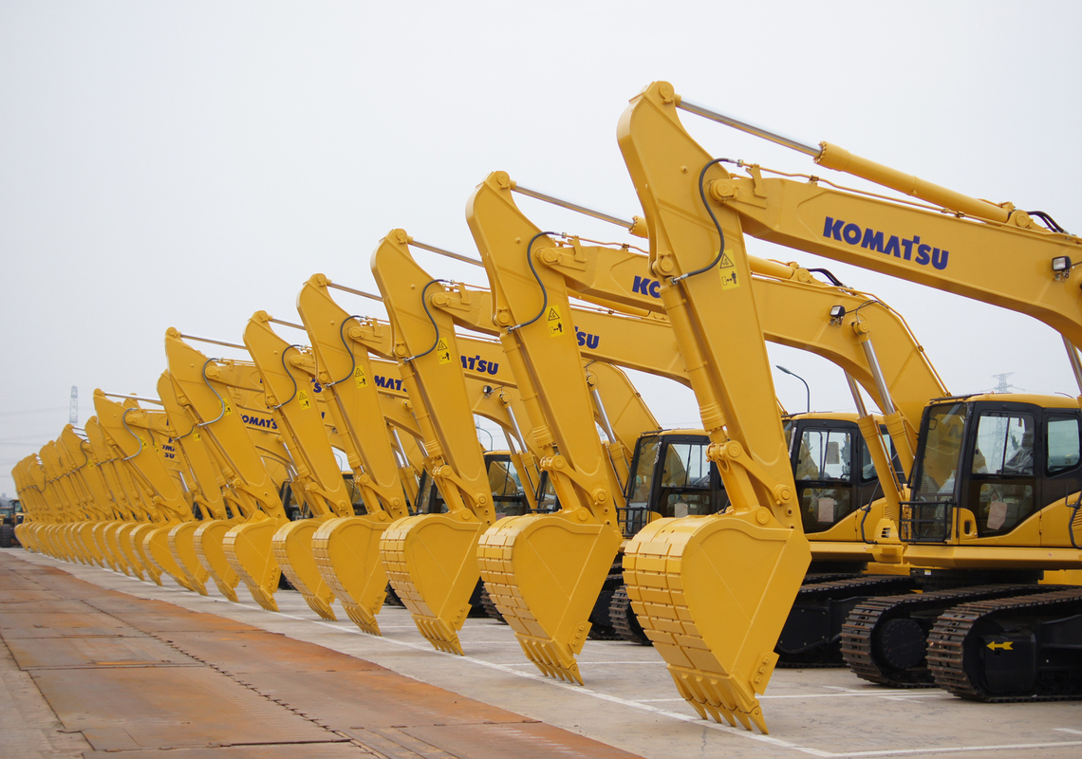
WELCOME
1
yumbo - sharing
Rental heavy equipments from peers, rather than a leasing company
Notes:
Hello everyone, today I gonna talk about prototype of my servise.
My concept is Rental heavy equipments from peers, rather than a leasing company
Yumbo means トラクター、ブルドーザー、シャベル
Here, I focused on especially construction company. ⇒

Slide 2
Problems
2
Price is a important concern for customers buying machines from Maker
Useless management cost is generating by 75%
non-operation machineries
Strict export restrictions by Exhaust gas regulation
in 2014 make getting secondly income difficult
Notes:
Now construction companyr face three major problems
First Due to the technology development,
The price of yumbo is getting higher, so It is a little dificult now to get a new one
Second, because of non better tools, 75% heavy equipment is inoperative now
so useless management cost is generating
Third, Strict export restrictions make getting secondly income difficult and comstruction campany have to have an old machine longer than ever. So ⇒

Slide 3
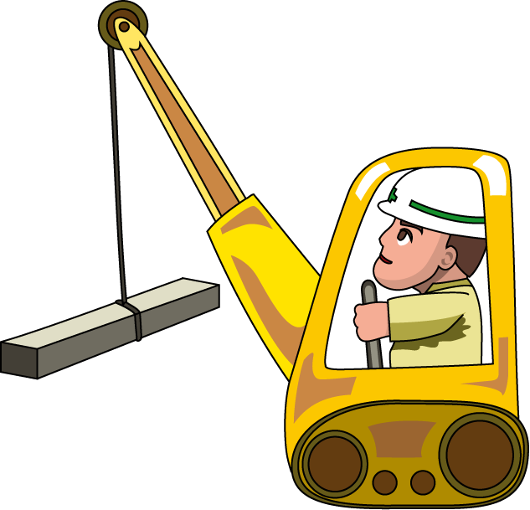
Product
4
Share
Constructor
Constructor
<For example>
SEARCH BY CITY&TYPE
REVIEW LISTINGS
RENT IT!
Notes:
we focused on constructor's domestic trading.
Let‘s share. we’ll make web sharing platform
For example of one flow is, search by area&type, look at review, and rent it.
By this platform ⇒
.

Slide 4
Solution
3
A web platform where construction company can share their
machineries with peers to:
SAVE
MONEY
Getting a new one
by sharing,
not leasing or buying
CUT
COST
Construction and
Management cost
MAKE
MONEY
When sharing
Problem 1
Notes:
①Constructor can
②saving money by sharing not buying or leasing,
③cutting useless cost,
④making new money by a new way sharing not exporting.
And ⇒

Slide 5
Market Size
5
$60 Billion
$20 Billion
$14 Billion
EQUIPMENT SHARE
CONSTRUCTION EQUIPMENT
SECONDRY
CONSTRUCTION EQUIPMENT
Total Equipment Market (JAPAN)
77% of total secondary equipment
Total Secondary
Equipment Market (JAPAN)
Notes:
We estimate that Market size is 14 biliion dollars
This is 77% of total secondary equipment market
This means 26 to 28 thouthant machines are non-operative.
So we focuse on construction company who has many non-operative machines
And ⇒

Slide 6
Business Model
6
Sharing price is half of leasing price
We take a 10% commission on each transaction
$60
$14 Billion
REVENUE
$600
$100
DELIVERY FEE
AVG FEE
$440
EQUIPMENT SHARE
$20/night @ 1 month
Source : $1200/month
is avg excavator rental price
HOST INCOME
77% of total secondary machinery
Notes:
This is bussiness model
In this equipment market , we assum sharing price is half of lease price
We take a 10% commission on each transaction from constructor
This is example of excavater.
10% of average fee is revenue, and 100hundred dollars is delivery fee, and tha last is host income.

Slide 7
Competition
7
Affordable
yumbo - sharing
Buying/Selling
Rentaling/Leasing
Expensive
Notes:
This is competiters.
Our service is located at up-right

Slide 8
Competitive Advantage
8
1ST TO MARKET
NEW EARNINGS
PERFECT TIMING
For transaction-based
Temporary machine using
Constructor
can make money
by rentaling
2011~ East Japan great earthquake
2014~ Fourth order exhaust gas regulation
2015~ Tokyo Olympic Demand
CHEAPEST TOOL
CREDIBLE PROFIEL
EASE OF USE
Constructor get
a new one as a cheapest price so far
Browse host profiles
and rent in a few click
Search by
price. Location. dates
Notes:
In this conpreitions,,
We have six major advanteges.
1st to market, we have no conpetiters in Japan but In US, There are similer service
New ernings. A new way of getting maney under tha situation that export is prohibited
Perfect timing, East Japan great earthquake Fourth order exhaust gas regulation Tokyo Olympic Demand really helps our model.
Cheaper than any other tools
Credible profile and ease of use

Slide 9
End
10
Thank you for listening
Please give me advice

